Slide 1
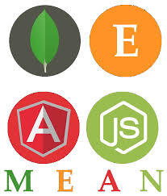
Node.js MongoDB
NoSQL Database

Slide 2
Database
Mostly all modern-day web applications have some sort of data storage system at the backend. For example, if you take the case of a web shopping application, data such as the price of an item would be stored in the database.
The Node.js framework can work with databases with both relational (such as Oracle and MS SQL Server) and non-relational databases (such as MongoDB).
NoSQL Database is a database design approach that provides a mechanism to store and access a wide variety of unstructured data in documents and collections.

Slide 3
Node.js and NoSQL Databases
NoSQL database such as MongoDB and MySQL have become quite popular as databases for storing data. The ability of these databases to store any type of content and particularly in any type of format is what makes these databases .
Node.js has the ability to work with both MySQL and MongoDB as databases. In order to use either of these databases, you need to download and use the required modules using the Node package manager.
For MySQL, the required module is called "MySQL" and for using MongoDB the required module to be installed is "Mongoose."
With these modules, you can perform the following operations in Node.js :
Manage the connection pooling – Here is where you can specify the number of MySQL database connections that should be maintained and saved by Node.js.
Create and close a connection to a database. In either case, you can provide a callback function which can be called whenever the "create" and "close" connection methods are executed.
Queries can be executed to get data from respective databases to retrieve data.
Data manipulation, such as inserting data, deleting, and updating data can also be achieved with these modules.

Slide 4
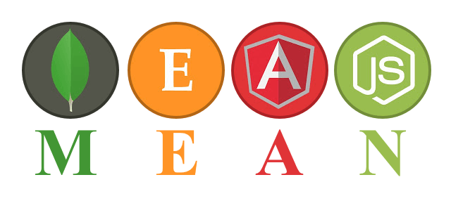

Slide 5
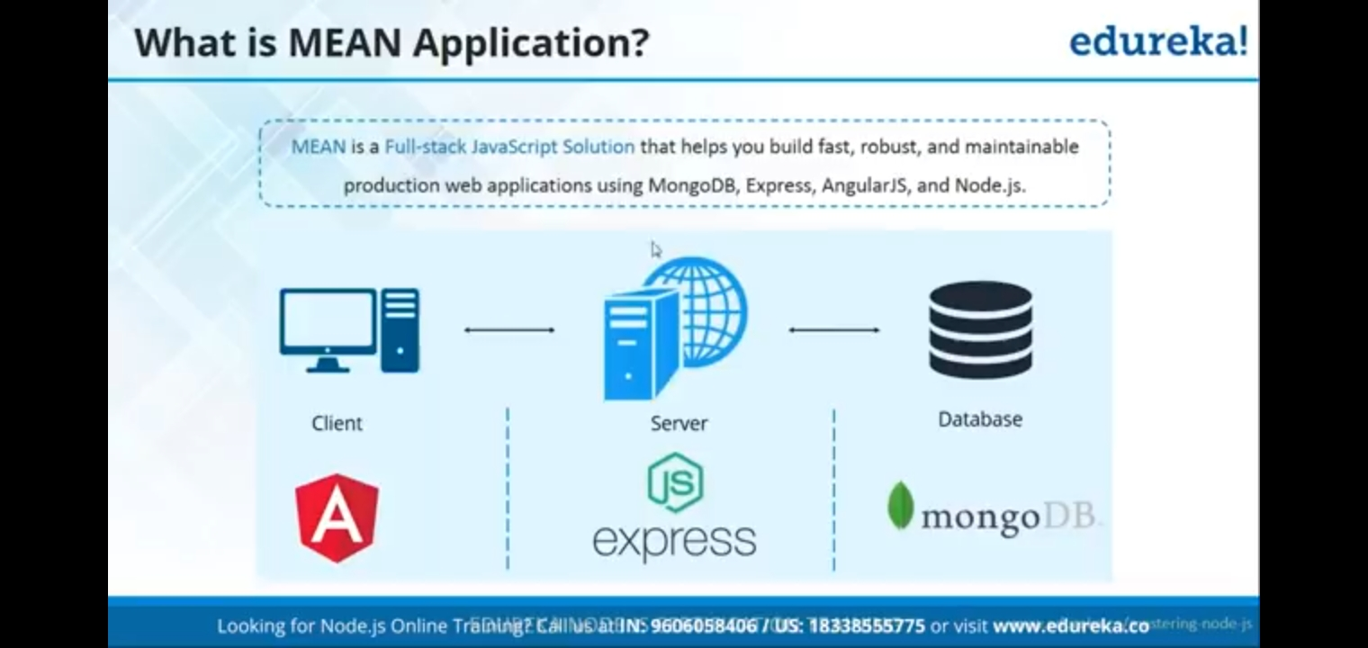

Slide 6
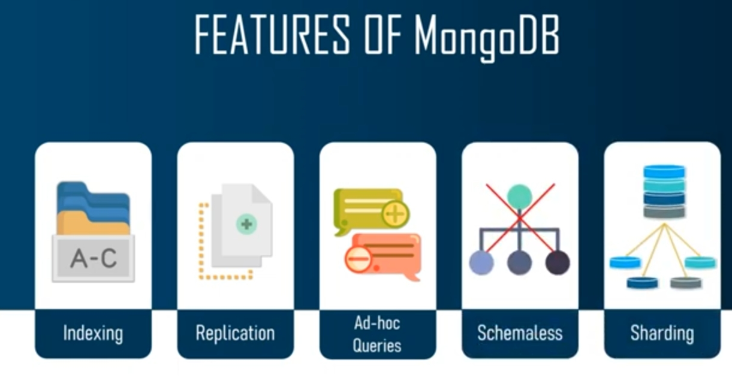
MONGO DB
MongoDB is an open source NoSQL database that uses a document-oriented data model.
It works on concept of collection and document.

Slide 7
Introduction to MongoDB
It is an open source non-relational database the stores the data in the form of collections and documents
It does not create any relationships, So what we do is we store everything in form of collections and documents .collections can be considered as a table and a document can be considered as a row for normal database when we create a table we define the structure of the table will be, but in this when we create a collection we don’t define any schema over here.
It preserves most of the functionalities while offering horizontal scalability.
It stores the JSON documents in the form of collections having dynamic schemas.
It stores all the related information together which enhance the speed of query processing

Slide 8
express
Express is a minimal and flexible Node.js web application framework that provides a robust set of features for web and mobile applications.
Express.js is a Node .js web application server framework, which is specifically designed for building single-page, multi-page, and hybrid web applications. It has become the standard server framework for node. js. Express is the backend part of something known as the MEAN stack.

Slide 9
ANGULAR
Angular 2 is a open source framework for building complex applications in the browser.
Developed by Google.
AngularJS is a JavaScript framework, whereas NodeJS is a cross-platform runtime environment. As a client-side JavaScript framework, AngularJS Angular enables developers to create dynamic web applications based on model-view-controller (MVC) architectural pattern and using HTML as a template language.

Slide 10
NODE
Node.js is an open source runtime environment for server-side and networking applications and is single threaded.
Provides an event driven architecture and non blocking I/O that is optimized and scalable

Slide 11
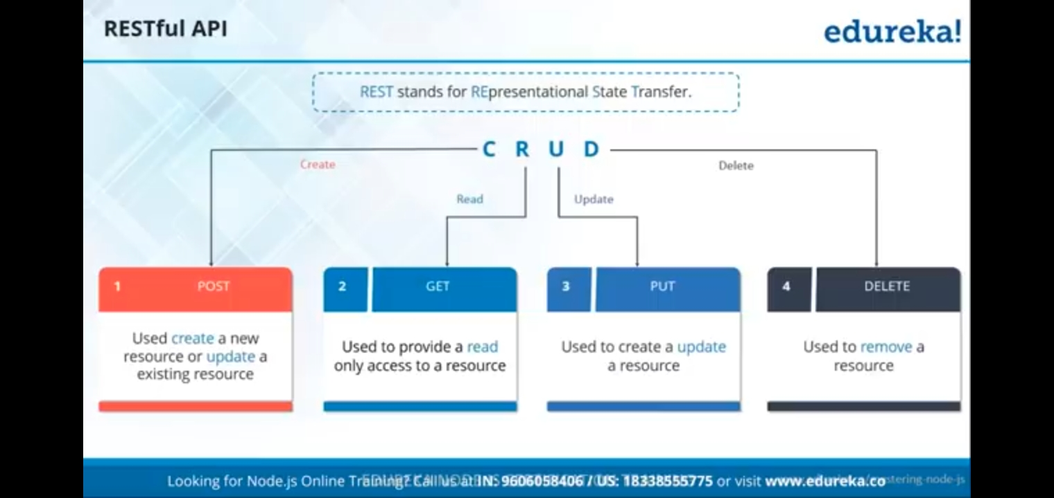

Slide 12
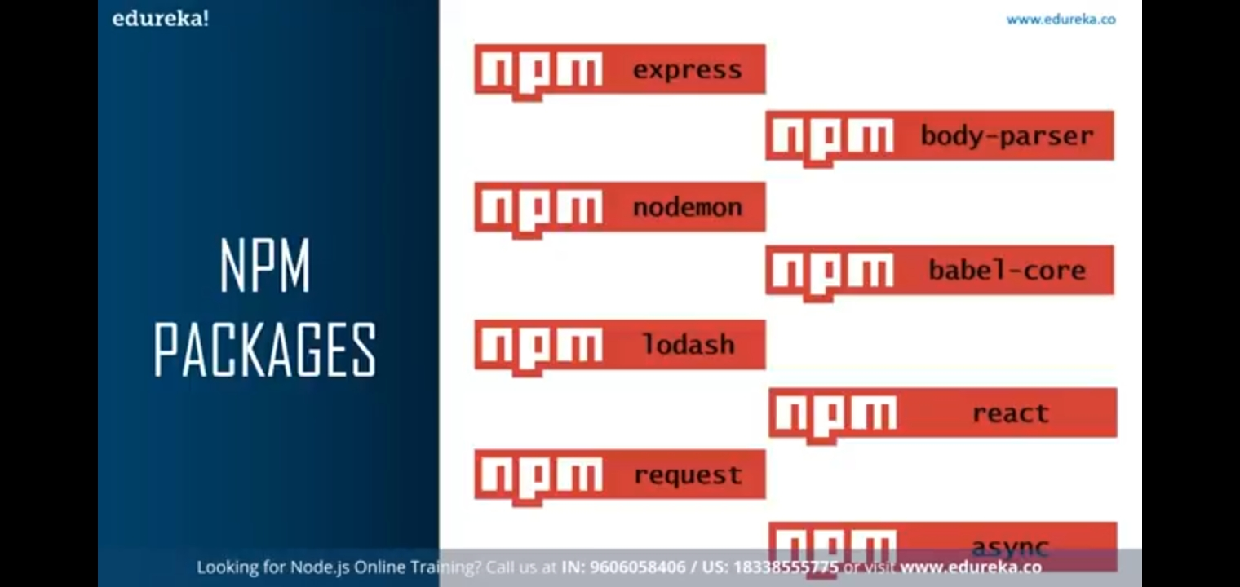
Installing the NPM Modules
You need a driver to access Mongo from within a Node application. There are a number of Mongo drivers available, but MongoDB is among the most popular. To install the MongoDB module, run the below command . npm install mongodb

Slide 13
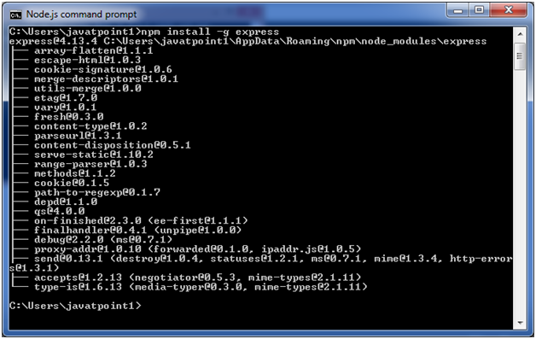
Install Express.js
Firstly, you have to install the express framework globally to create web application using Node terminal. Use the following command to install express framework globally.
npm install -g express

Slide 14
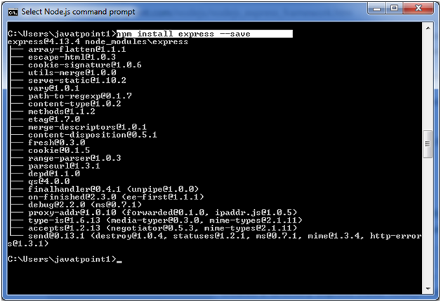
Installing Express
npm install express --save
The above command install express in node_module directory and create a directory named express inside the node_module.

Slide 15
HOW to install MONGO DB
https://youtube.be/FwMwO8Xfq0://

Slide 16
Using MongoDB and Node.js
MongoDB is one of the most popular databases used along with Node.js.
How we can establish connections with a MongoDB database
How we can perform the normal operations of reading data from a database as well as inserting, deleting, and updating records in a MongoDB database.
Database name: Employee DB
Collection name: Employee
Documents
{
{Employeeid : 1, Employee Name : Guru99},
{Employeeid : 2, Employee Name : Joe},
{Employeeid : 3, Employee Name : Martin},
}

Slide 17
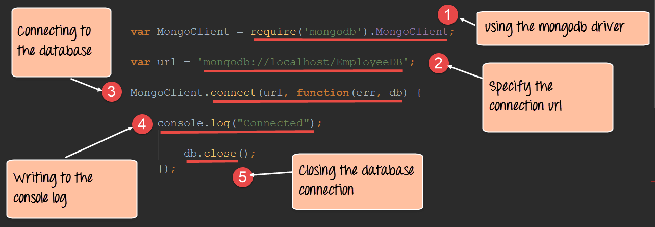
Creating and closing a connection to a MongoDB database

Slide 18
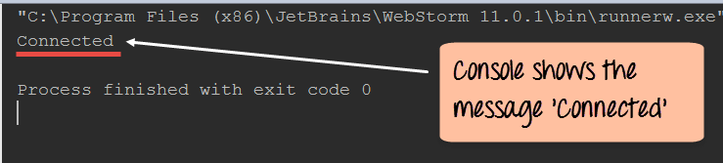

Slide 19
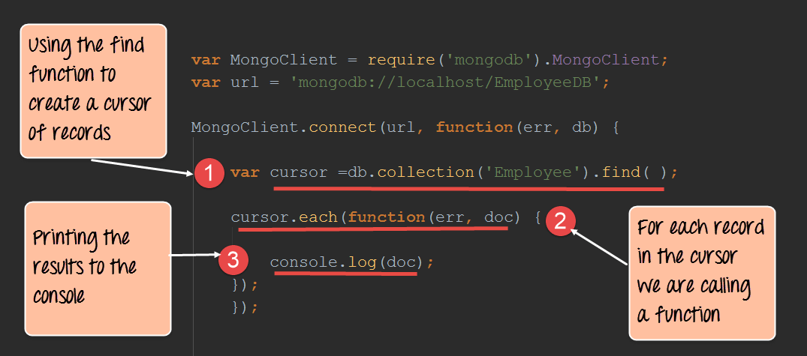
Querying for data in a MongoDB database
Using the MongoDB driver we can also fetch data from the MongoDB database. The below section will show how we can use the driver to fetch all of the documents from our Employee collection in our EmployeeDB database. This is the collection in our MongoDB database, which contains all the employee-related documents. Each document has an object id, Employee name, and employee id to define the values of the document.

Slide 20
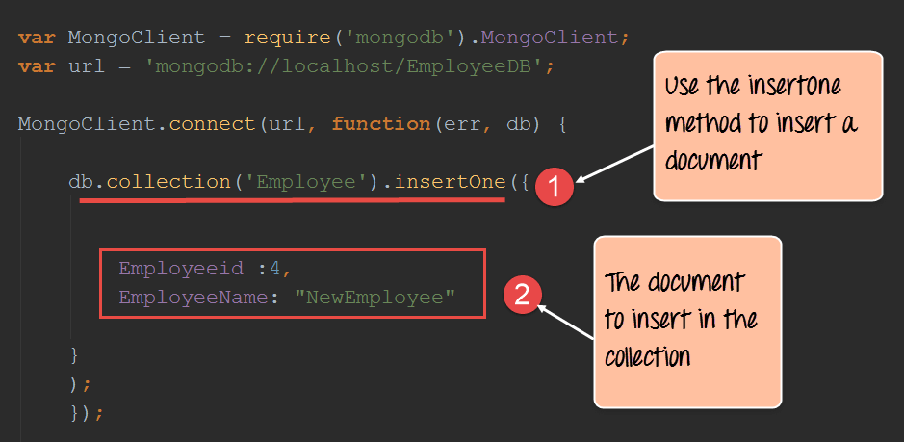
Inserting documents in a collection
Documents can be inserted into a collection using the insert One method provided by the MongoDB library

Slide 21
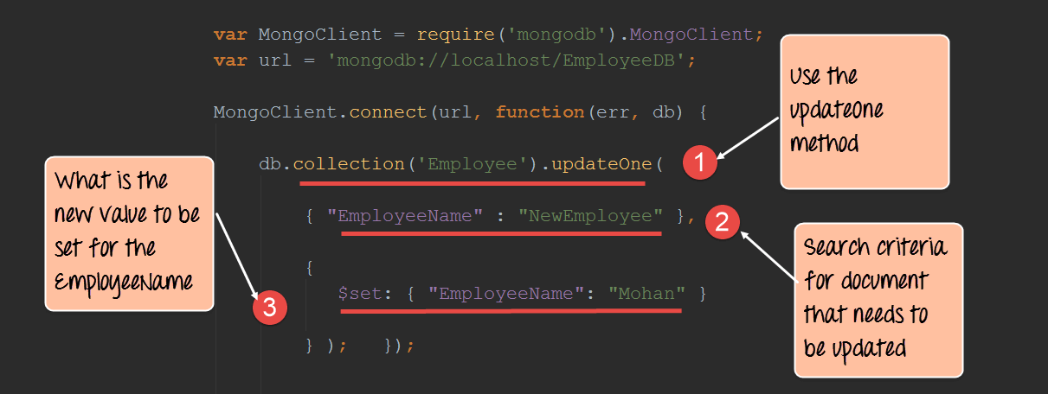
Updating documents in a collection
Documents can be updated in a collection using the update One method provided by the MongoDB library

Slide 22
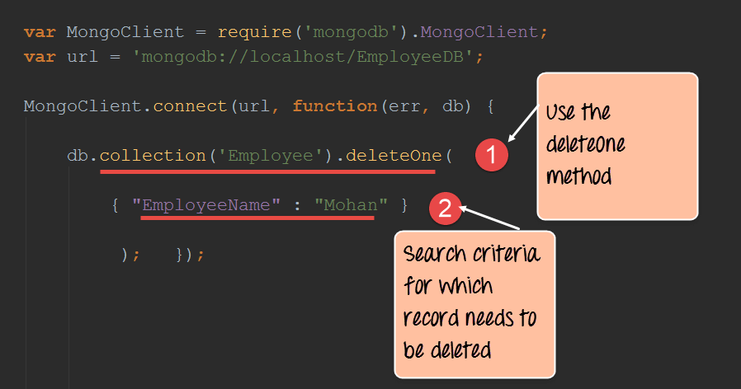
Deleting documents in a collection
Documents can be deleted in a collection using the "deleteOne" method provided by the MongoDB library.

Slide 23
How to build a node express app with MongoDB to store and serve content
Building an application with a combination of both using express and MongoDB is quite common nowadays.
When working with JavaScript web based applications, one will normally here of the term MEAN stack.
The term MEAN stack refers to a collection of JavaScript based technologies used to develop web applications.
MEAN is an acronym for MongoDB, ExpressJS, AngularJS, and Node.js.
Let's look at a simple example of how we can use "express" and "MongoDB" together. Our example will make use of the same Employee collection in the MongoDB EmployeeDB database.
We will now incorporate Express to display the data on our web page when it is requested by the user. When our application runs on Node.js, one might need to browse to the URL http://localhost:3000/Employeeid.

Slide 24
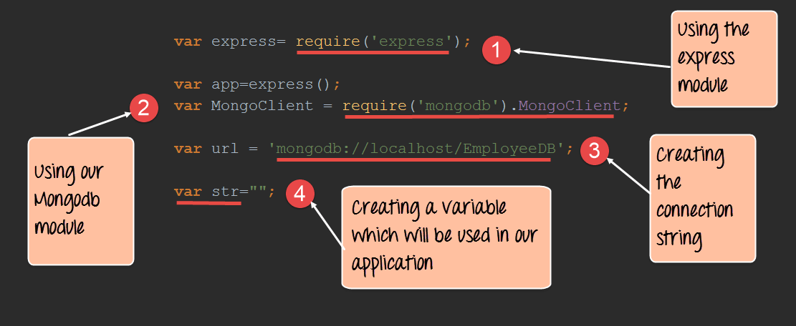
Step 1) Define all the libraries which need to be used in our application, which in our case is both the MongoDB and express library.

Slide 25
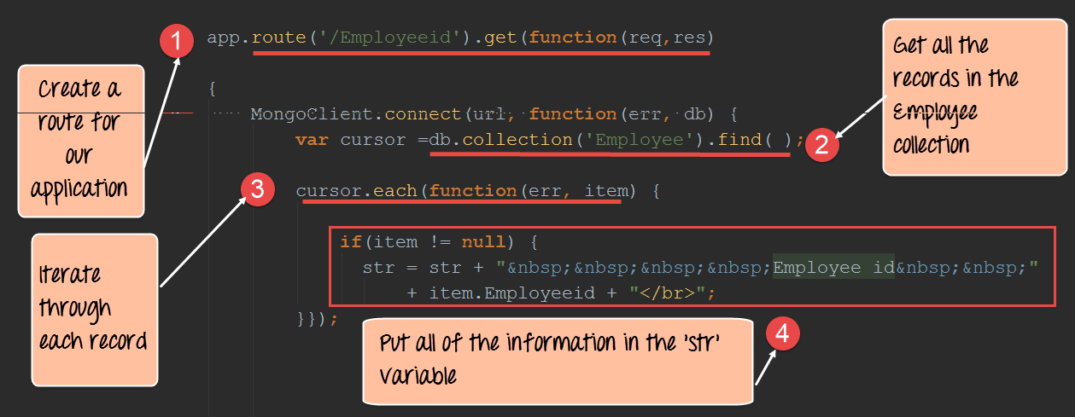
Step 2) In this step, we are now going to get all of the records in our 'Employee' collection and work with them accordingly.

Slide 26
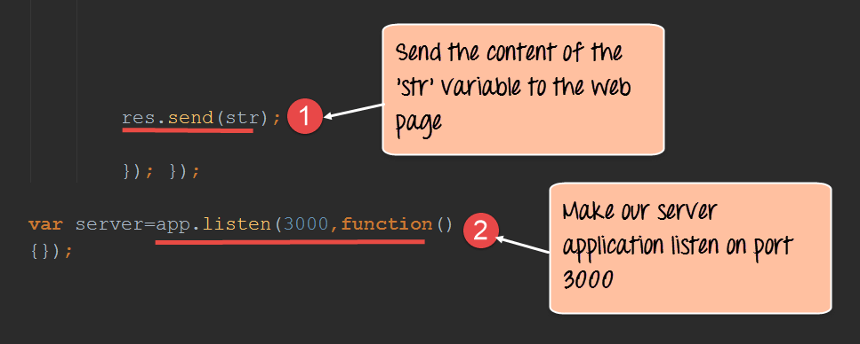
Step 3) In this step, we are going to send our output to the web page and make our application listen on a particular port.

Slide 27
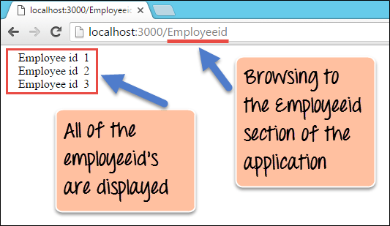
output

Slide 28
conclusion
Node.js is used in conjunction with NoSQL databases to build a lot of modern days web applications. Some of the common databases used are MySQL and MongoDB.
One of the common modules used for working with MongoDB databases is a module called 'MongoDB.' This module is installed via the Node package manager.
With the MongoDB module, it's possible to query for records in a collection and perform the normal update, delete and insert operations.
Finally, one of the modern practices is to use the express framework along with MongoDB to deliver modern-day applications. The Express framework can make use of the data returned by the MongoDB driver and display the data to the user in the web page accordingly

